Slide 1
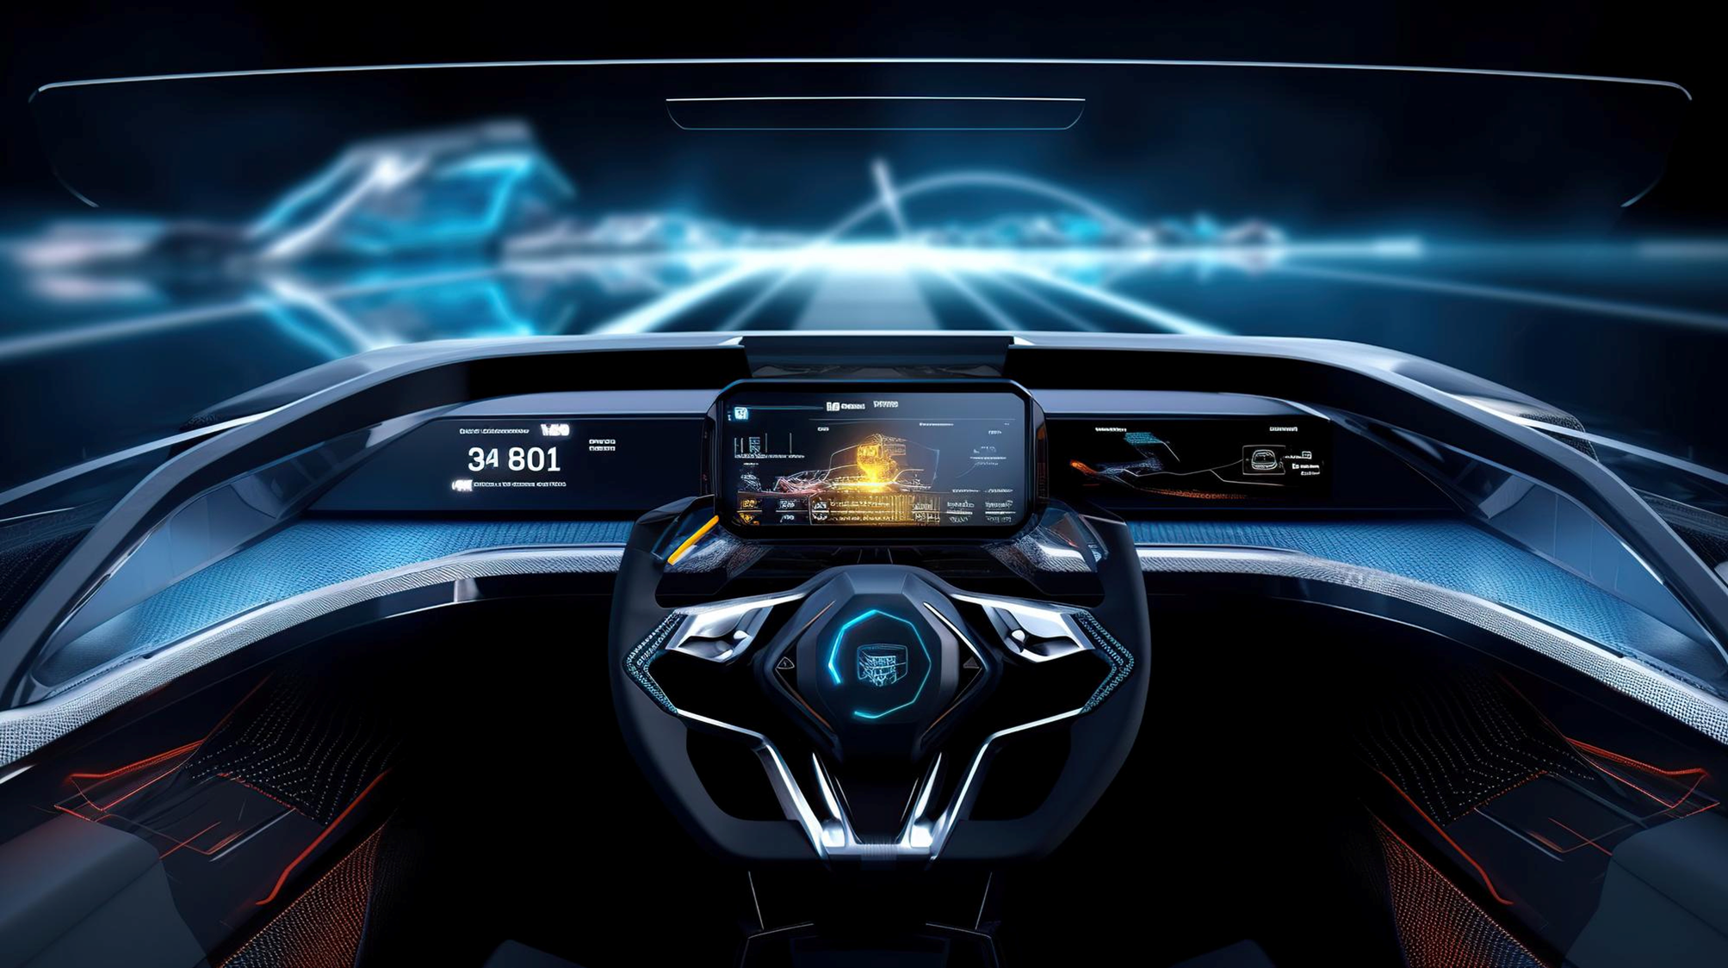


Fact Check
Intelligent Driver Drowsiness Avoidance System

Slide 2

Fact Check
Globally, driver drowsiness contributes to around 1.25 million road deaths and up to 50 million injuries each year

Slide 3



Our Vision
Our Vision
Reduce fatal accident due to driver drowsiness
Enjoy the ride
Knowledge Extension

Slide 4
Engagement State
Accoustic engagement is activated
Level 1
Level 2
Level 3
Level 4
Joyful Ride
Entertainment
Knowledgeful Ride
Need your Attention
Annoy until you obey
Attention Level
Driving Reaction Time
To AI Assistant
AI Assistant Engagement
Frequency

Slide 5





System Architecture
Function Control Unit
Drowsiness
Detection
State Machine
Conversational Agent
Camera
<engagment_state>
<location>
<fatigue_level>
<drowsy_score>
Vehicle Signal Specification
Vehicle Signal Specification
<drowsy_score>
Vehicle API (Broker)
Position
<long, lat>
Vehicle (Simulation)

